Slide 1

ARCITECTURE DIAGRAMS
GROUP MEMBERS:
NIMRA MAQBOOL F2023266852
khalida
saba yasin
hareem

Slide 2
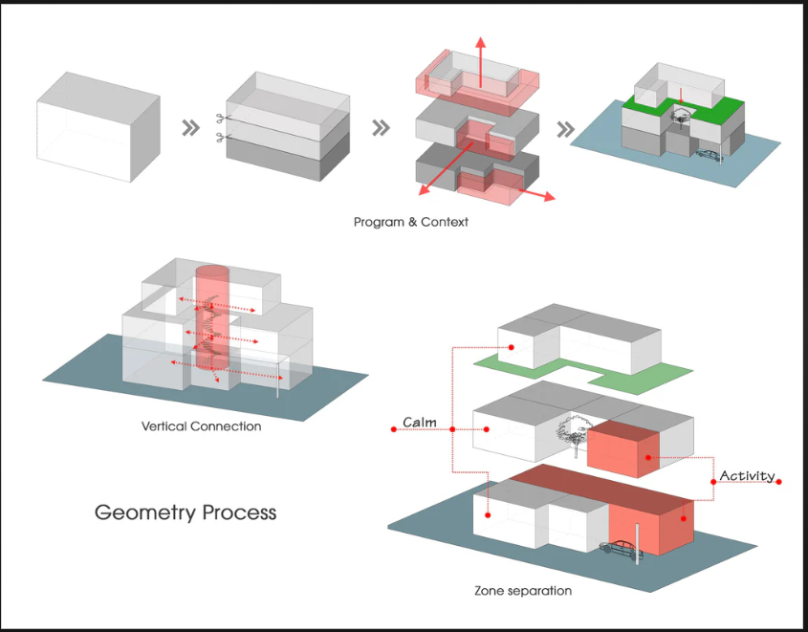

WHAT ARE ARCITECTURE DIAGRAMS?
“An architecture diagram visually represents the relationships, components, and structure of a system, making it easier for teams to understand and design the system effectively.”
Source: nulab.com

Slide 3
Types of Architecture Diagrams
Layered Architecture Diagram
Client-Server Architecture Diagram
Microservices Architecture Diagram
“This diagram shows the system broken down into separate layers like Presentation, Business Logic, and Data Layers.”
Example:
Presentation Layer: Handles UI (HTML, CSS, JavaScript).
Business Logic Layer: Processes operations (Java/Python).
Data Layer: Stores data in databases (MySQL/PostgreSQL).
Source: Lucidchart blog on Layered Architecture
“This diagram illustrates communication between clients (devices) and servers over a network”
Example:
A browser (client) sends a login request to the server, which processes it and returns the user profile.
Source:Medium - Client-Server Architecture
“This diagram represents a system as independent, smaller services, each handling a specific function.”
Example:
Order Service: Manages orders.
Payment Service: Processes payments.
Notification Service: Sends alerts.
Source:Martin Fowler’s Microservices Overview.

Slide 4
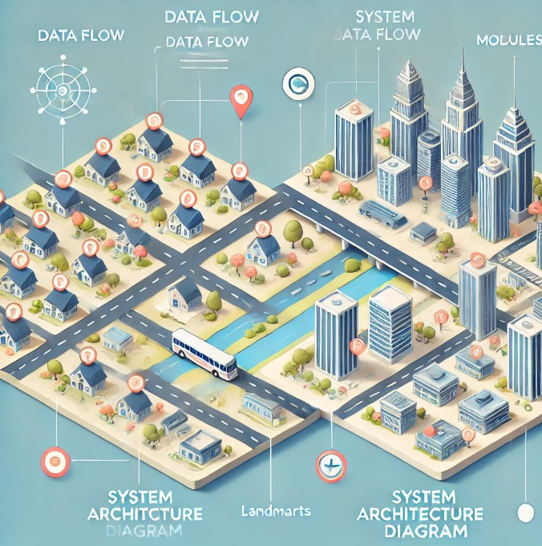
Real-life Example: Architecture Diagrams as City Maps
Imagine you are visiting an unknown city. Without a map, navigating the city is confusing and time-consuming. A city map shows you the layout, including roads, landmarks, and key connections, helping you understand where you are and how to get to your destination . Now, think of an architecture diagram as a map for a system:
City Layout: Represents the structure of the system (e.g., components like servers, databases, and services).
Landmarks: Represent important system modules or key functionalities.
Roads: Represent the communication or flow of data between components.
Architecture diagrams are like city maps, helping teams understand and navigate complex systems.
(Source: arXiv.org)

Slide 5
Components for Architecture Diagrams
.
.
.
Nodes:
Represent physical/logical components such as
servers,
applications modules
Labels
Provide descriptive names and explanations for components and their connections
Artifacts
Represent tangible elements such as documents , data base schemas or deployment packages.
Connections
Show interactions like data flow, API calls, or network links between components.
Boundaries
Define scope of system or subsystems indicating what is inside or outside

Slide 6
How is an Architecture Diagram Helpful?
Designing ,communication and understanding the system:
- They act as blueprints for system design, planning layout and ensuring seamless interactions.- They facilitate clear communication among stakeholders, illustrating roles and responsibilities.- They provide a shared understanding of the system, helping teams comprehend complex systems for easier maintenance.
they help to understand the system in fillowing ways:
1)Conceptual arcitecture
Provides high-level system overview.
answers the question: What does the system do?
2)Logical architecture
focuses on the relationships and interactions between system components, highlighting the functional flow of data and processes.
Foccus on questions like: "How do the components interact?"
3) Physical Architecture
represents the system's actual implementation, covering hardware, software, and network configurations.
It answers "How is the system physically implemented?“ source:medium

